Slide 1
Pre-workshop questionnaire
Capacity to implement IMTS 2026 and MSITS 2026; Demand and capacity to implement integrating Business and Trade Statistics
by
Vysaul Nyirongo (email: nyirongov@un.org)

Slide 2
Objective of the survey
Capacity of countries to implement IMTS 2026 and MSITS 2026.
Demand and capacity to implement integrating Business and Trade Statistics.

Slide 3
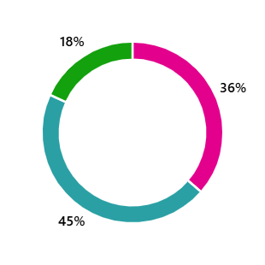
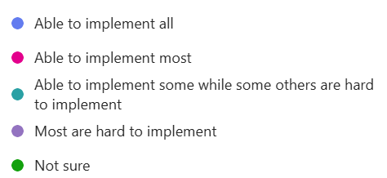
Ability to implement the IMTS 2026 updates

Slide 4
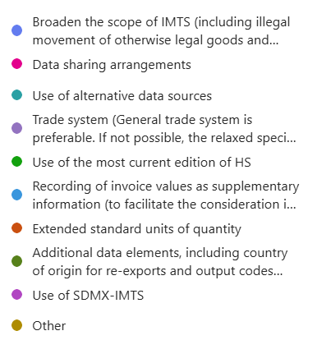
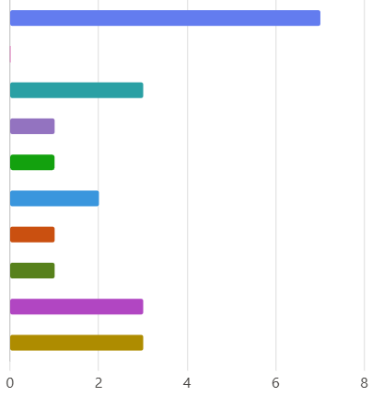
Updates or enhanced recommendations in IMTS 2026 that may be challenging to implement
The difficulty of classifying modern goods,–Limitations in international cooperation and data sharing and services,

Slide 5
Main challenges foreseen in implementing the updated recommendations in IMTS 2026
Measuring hidden or informal trade, illegal movement of legal goods, smuggling and undeclared cross-border trade
Lack of alternative data beyond traditional sources;
Capturing these requires advanced methods (e.g. surveys, A.I), but raises confidentiality and comparability issues.
International comparability
Use of different national data collection methods.
Increasing environmental concerns may necessitate updates in how goods are classified and monitored.

Slide 6
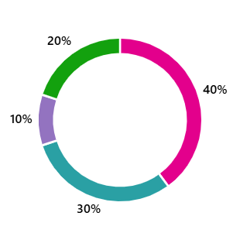
Ability to implement the MSITS 2026 updates

Slide 7
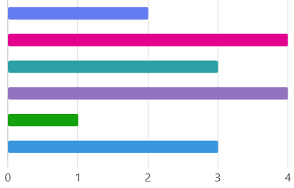
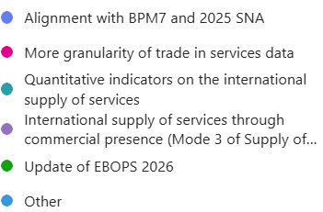
Updates or enhanced recommendations in MSITS 2026 that may be challenging to implement
Introduction of modern data collection and analysis systems

Slide 8
Main challenges foreseen in implementing the updated recommendations in MSITS 2026
Introduction of complex concepts and data needs to address modern economic developments like digital services and global platforms
Implementing these changes will require overhauling current statistical systems (e.g. limitations of ITRS, and current surveys);
Rapid digital innovation, such as in fintech, e-commerce, and cryptocurrencies, add further difficulty, often outpace legacy systems.
Understanding and applying the new standards, including aligning with BPM7 and the 2025 SNA.
Incomplete data on cross-border and digital services, and legal issues related to privacy and regulation.
Difficulties due to infrastructure and experience gaps.

Slide 9
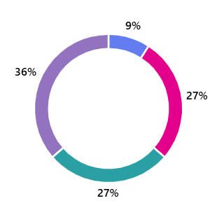
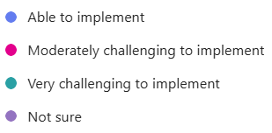
Demand and capacity to implement integrating Business and Trade Statistics
Capacity to implement the integration of business and trade statistics

Slide 10
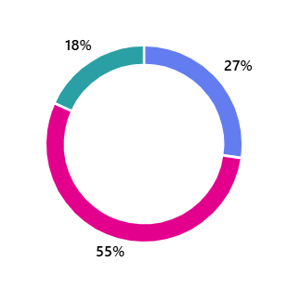
Demand and capacity to implement integrating Business and Trade Statistics
Level of priority on integrating business and trade statistics

Slide 11
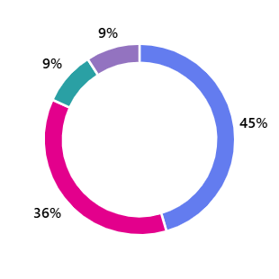
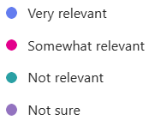
Demand and capacity to implement integrating Business and Trade Statistics
Policy relevance of integrating business and trade statistics

Slide 12
Demand and capacity to implement integrating Business and Trade Statistics:
Main challenges in integrating business and trade statistics
Different data sources, with different concepts and coverage: harmonization, standardization, or linking data can be difficult.
Institutional arrangements
Lack of SBR; Legal framework to establish SBR;
Data confidentiality principles among partner agencies
Activities in the informal sector.
Intra-firm transactions and transfer pricing of MNEs are hard to measure.
Integrating social dimensions (gender, sustainability and inclusion) is complex
Difficulty generating TEC and STEC

Slide 13
About the Workshop:
Topics that the workshop can focus on
The role of statistical agencies in compiling trade in services statistics.
Countries' experiences in linking trade and business statistics.
Trade indicators and dissemination.
Legislative changes that help establish a business register and amend trade statistics.
Digital trade statistics.
Key Changes for IMTS and MSITS (including anticipated challenges, and suggested solutions):
Data collection and analysis methodology updates Conceptual framework, trade system, and trade asymmetries Classification of goods and services | Net weight and quantity information Measurement of trade in transport services, telecommunications, and financial services, especially quantitative indicators

Slide 14
Type of support needed for implementing IMTS, MSITS, and/or HIBTS
Training workshop, sharing best practices and study visits
Insights into different practices, especially with countries that have successfully adopted the changes;
Mechanisms for sharing best practices;
More details for the topics and illustrate them by examples.
Roadmap for the identification of challenges and the implementation of new recommendations
Technical support on how to collect trade in services statistics.
Remote training

